Slide 2



ITU Digital Consumer Forum 2019
Models of ICT Self-Regulation for Africa
Dr Charley Lewis
Notes:
2

Slide 3
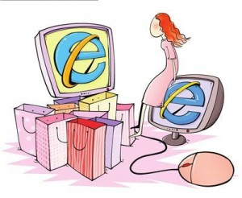

Consumer Protection in a Digital Platform World

Slide 4


Consumer Protection in a Digital Platform World
New ranges of issues thrown up by:
  e-Commerce
  Social Media (privacy, personal information)
  Big Data, Data Analytics, AI
  Cloud Computing, IoT, 5G
  M-money, FinTech, Cryptocurrency
  Plethora of illegal and harmful content (eg kiddie porn - Google’s watching you!)
  Net Neutrality
  OTT services
  Online content piracy

Slide 5
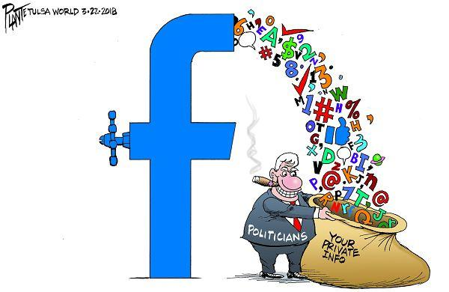
Self-regulation in practice
Cambridge Analytica et al
  Elections meddling in US, UK, Kenya
  Bell Pottinger & ‘white monopoly capital’ in SA
Internet / social media shut-downs
  Chad, DRC, Ethiopia, Gabon, Liberia, Sierra Leone, South Sudan, Sudan, Togo, Zimbabwe
  21 shut-downs in 2018 alone
Christchurch Massacre
  Live-streaming of terrorist attack
  Led to Christchurch Call for co-regulation
Boeing 737 Max
  Industry self certification & FAA

Slide 6

Self-regulation in the context of an evolving ICT Sector…

Slide 7
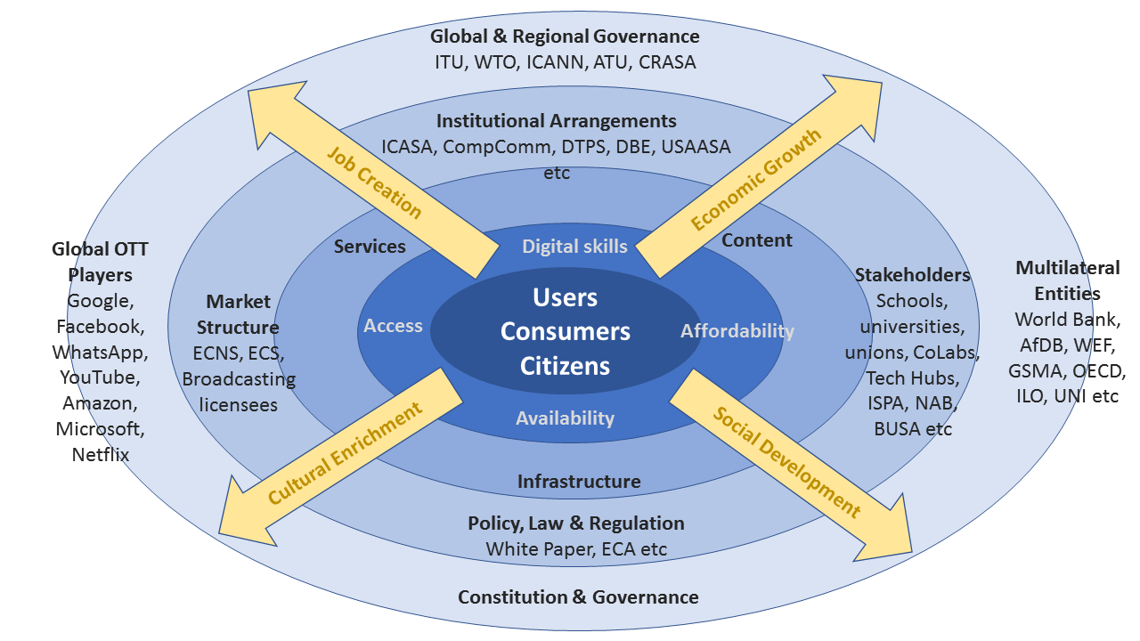
ICT Sector as an Ecosystem

Slide 8
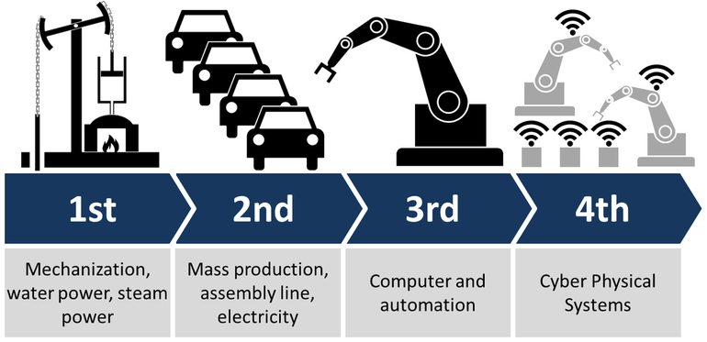
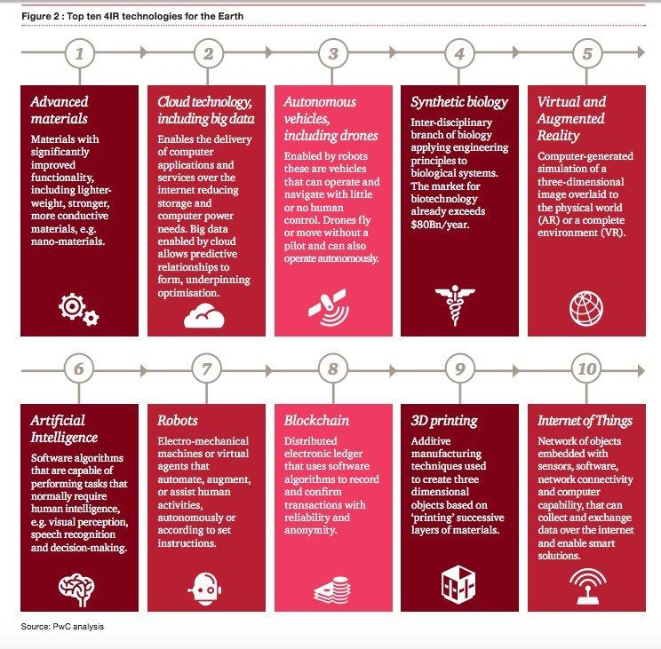
ICT and the ‘4th Industrial Revolution’
4IR - driven by cyber-physical systems & fusion of technologies
Demolishes divisions between the physical, digital, & biological
Revolutionises economy, work, society
Big data + IoT + AI = Big danger
Graphics: Christoph Roser, PWC

Slide 9
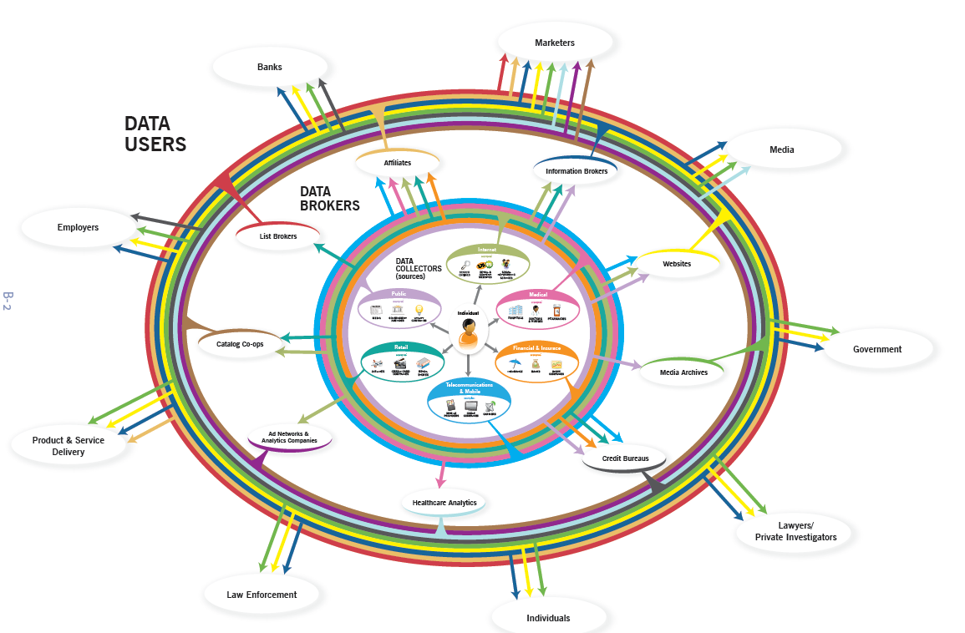
Personal Data as an Ecosystem
Source: FTC, 2012

Slide 10
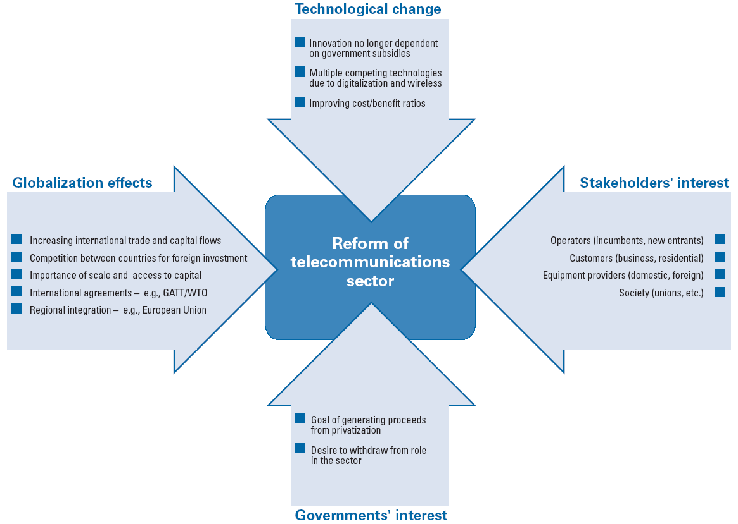
Forces driving ICT sector reform
Source: Beardsley et al, 2002

Slide 11

Components of ICT sector reform
Separation of powers & functions
  Policy formulation → government
  Telecomms regulation → independent regulator
  Telecomms services → commercial operators
Separation of posts & telecomms
Commercialisation of service providers
National telecomms / information society policies
Privatisation of the incumbent (SEP / IPO)
Creation of an independent sector regulator
Licensing new mobile operators & additional PSTS / broadcasting providers
Liberalisation - telecomms competition
Rate rebalancing (local vs international call charges)
Interconnection requirements
Universal service & universal access interventions
Regulation → deregulation → re-regulation
Notes:
11

Slide 12
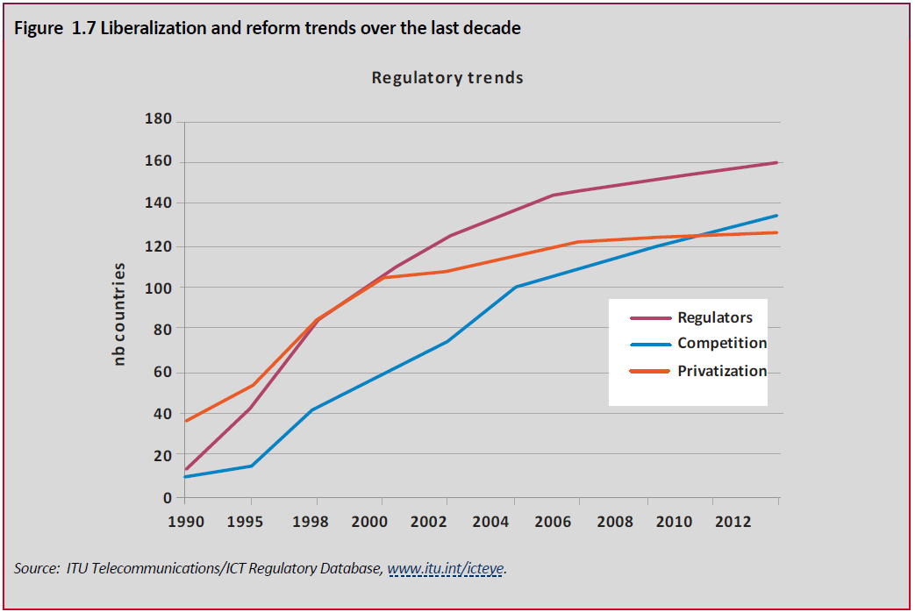
ICT sector reform (1990 – 2013)
Source: ITU, 2013

Slide 13
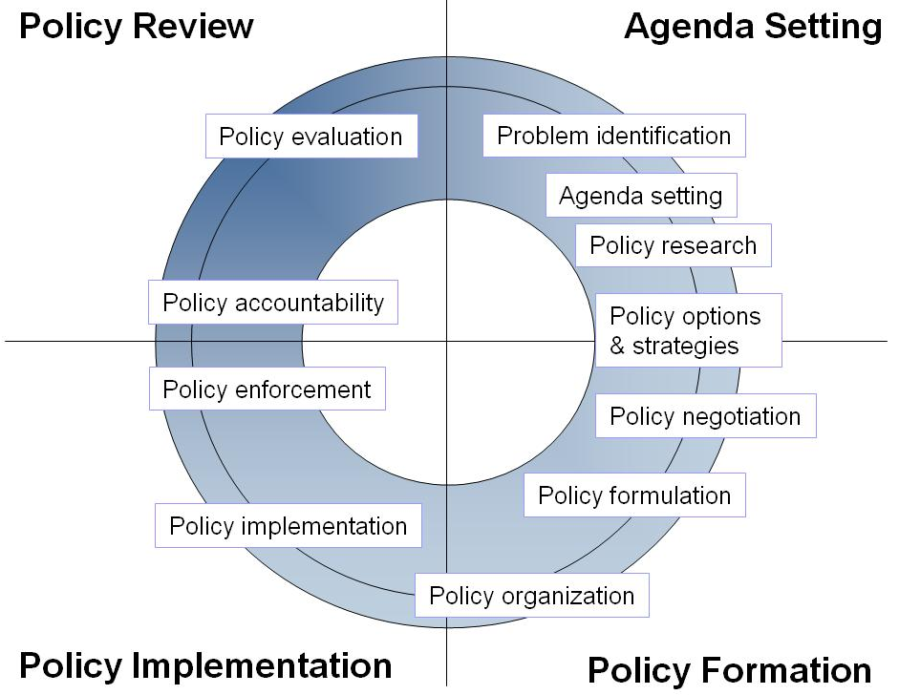
ICT Sector
Policy & Regulation

Slide 14

What do we mean by ICT Sector Regulation?
Intervention in the ICT market
  to address market failures
  State / NRAs / Industry
Policy ⬄ law ⬄ regulation?
  which is primary? secondary?
  which takes precedence?
  relationship?
Are laws the best mechanism to give effect to regulation?
Notes:
Defining regulation
In the context of this module, regulation is defined to mean government agency intervention in the affairs of actors in the market place. The actors in the market place include telecommunications network operators, whether fixed line or mobile; and value added network service providers.
Inevitably, regulation implies defining the degree of intervention of government agency in the market place. The rules that define the degree of intervention are usually contained in laws passed by the assembly of the national government concerned. Regulation also implicates defining the nature of the relationship between the government agency and the actors in the market place.
In turn, the laws are defined by the policies fixed in the country under discussion. Deciding what policy defines the laws is often a matter of controversy. Debates about policy take place at two interrelated levels:
· What is the content of the policy?
· Who is involved in deciding what that policy is?
The content of policy for telecommunications is influenced by sector specific needs but may also be influenced by the national objectives set for the country in question. This is especially the case in so-called developing countries. Telecommunications is perceived as presenting developing countries with an opportunity for economic leap-frogging and thus often receives special attention from government. The tendency in so-called developing countries is that the policies informing sector specific regulation are a part of the policies informing how society at large is ordered.

Slide 15
Policy, Law & Regulation
Policy
Executive
The Minister, ICT Dept
Legislature
Parliament,
Portfolio Committees
Law
Regulation / Judiciary
Sector Regulator
Competition Authority
Consumer Protector,
Data Regulator etc
Regulation

Slide 16
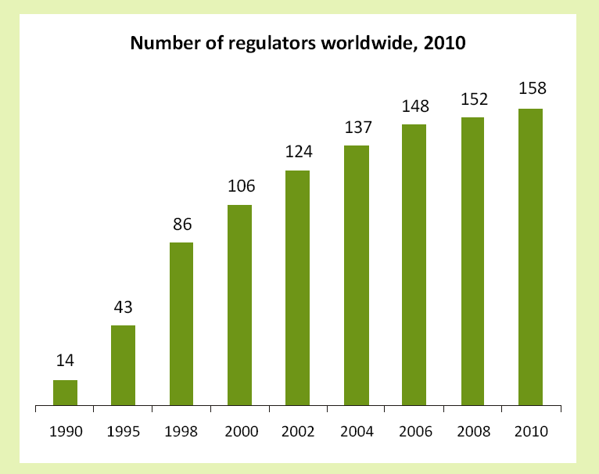
Independent Regulation
(The key decade: 1990 – 2010)
Source: ITU,
Trends in Telecomms
Reform, 2011
Notes:
16

Slide 17
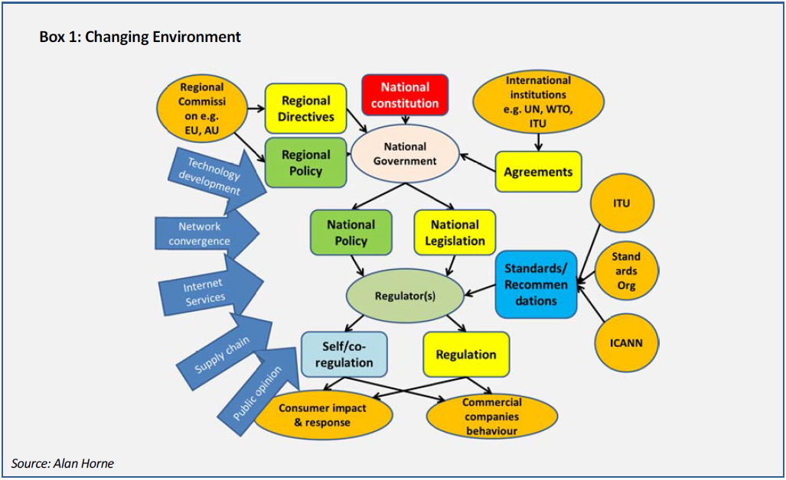
4th Generation Regulation
Source: Horne, GSR 2013

Slide 18
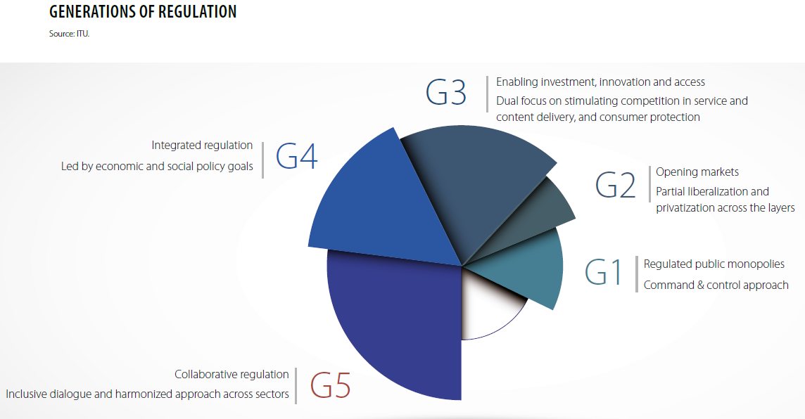
Pressure on policy-making & regulation

Slide 19


ITU Regulatory Guidelines
Fostering emerging technologies for digital transformation
  flexible light-touch, multi-sectoral, forward-looking, neutral, transparent policy and regulatory approaches
  enabling environment for emerging technologies
  cybersecurity response measures
Business & investment models to support digital transformation
  encourage innovation and effective competition, support the protection of consumers
  support foundations of the digital ecosystem, thro cross-sectoral collaboration, competition, convergence and administrative simplification
Policy & regulatory approaches for continued innovation
  innovative, out-of-the-box measures (eg regulatory sandboxes)
  public participation and consultation in the regulatory process
  effective mechanisms for cross-sectoral cooperation
  frameworks to ensure privacy and security of govt, business and consumer data
Source: ITU, 2018

Slide 20


ITU Regulatory Guidelines
Design principles for collaborative regulation
  Policy and regulation should be more holistic
  Cross-sectoral collaboration – revisit co-regulation and self-regulation
  Policy & regulation - consultation and collaboration based
  Evidence-based, outcome-based, incentive-based
Benchmarks for regulatory excellence & market performance
  Connectivity mapping:
  Metrics for market performance:
  Measuring regulatory maturity
  Impact assessment
  Regulatory roadmaps
Regulatory tools and approaches to enable digital experimentation
  Foster digital experimentation (eg regulatory sandboxes, technology pilots)
  Stakeholder engagement
  Robust, enforceable mechanisms for consumer protection - incl rules on data protection, privacy and data portability
Source: ITU, 2019

Slide 21

Why Regulate?

Slide 22
Some Regulatory Objectives
Promote universal access to basic telecommunications services
Foster competitive markets to promote:
  efficient supply of telecommunications services
  good quality of service
  advanced services, and
  efficient prices
Prevent abuses of market power by dominant firms (eg excessive pricing & anti-competitive behaviour)
Create a favourable climate to promote investment to expand telecommunications networks
Promote public confidence in telecommunications markets through transparent regulatory and licensing processes
Protect consumer rights, including privacy rights
Promote increased telecomms connectivity for all users through efficient interconnection arrangements
Optimise use of scarce resources (eg radio spectrum, numbers, rights of way)
Source: Intven, 2001

Slide 23

Rationales for Regulation
Regulation in the ‘public interest’
  Social objectives
  Economic objectives
  Competitive objectives
  Technical objectives
What institutional models are most appropriate to implement them?

Slide 24

Rationales for Regulation
Social objectives of ICT sector regulation
  Promote universal service / access
    USOs, USF
  Ensure consumer protection
    Price & quality of service regulation
    Complaints & dispute resolution
  Optimise use of scarce resources
    Spectrum, numbers, rights of way
  Ensure & protect access to information
    Media diversity, freedom of information, local content, cross-media ownership & control, cybersecurity

Slide 25
Rationales for Regulation
Economic objectives of ICT sector regulation
  Market structure
    Natural monopolies & market failures
  Rate regulation
    Rate rebalancing
    Price cap
    Rate of return
  Access regulation
    Interconnection regime
    Facilities leasing, essential facilities
    Infrastructure sharing, LLU, open access
    Accounting separation

Slide 26
Rationales for Regulation
Competitive objectives of ICT sector regulation
  Promote “fair” competition
  Ensure non-discriminatory rules
  Symmetrical vs asymmetrical regulation
  Prevent abuse of market dominance
  Promote innovation (advanced services)
How much of a competitive role should a sector-specific regulator play?

Slide 27

Regulation & the WTO
‘Telecommunications Services: Reference Paper’ (WTO, 24 April 1996) provides for
Competitive safeguards
  Anti-competitive practices (subsidies, information)
Interconnection
  Non-discrimination, timely manner, PoIs, publicly available & transparent procedures, dispute settlement procedures
Universal Service
  Right to impose USOs
Public Availability of Licensing Criteria
Independent Regulators
  Independence from suppliers
Allocation & Use of Scarce Resources
  Frequencies, numbers, rights of way

Slide 28

Regulatory
Strategies

Slide 29
Some Regulatory Strategies
Command & Control regulation
Incentive-based regulation
Market control regulation
Disclosure regulation
Asymmetrical regulation
Self-regulation / Co-regulation
Yardstick / Benchmark regulation
Combination?
Source: Baldwin & Cave, 2012

Slide 30
Styles of enforcement: compliance vs deterrence
Pyramid of
Enforcement
Strategies
(Hutter)
Command
Regulation
Insistent Strategy
Intrusiveness
Persuasive Strategy
Enforced self-regulation
Notes:
Discuss the importance of these principles in creating a stable sector, conducive to investment, based on credibility of the regulator.
See Baldwin - Chapter 6
Values of Effective Regulation
Accountability: To government; courts; industry and consumers. Accountability embraces independence. Subject to review or appeal procedures, regulators decisions should have a quality of finality and be accorded full recognition.
Openness and transparency: Policies and procedures accessible to all and simple to use. Public hearings and the provision of reasons for decisions.
Objectivity and informed decision-making: Decisions and rules must be based on identified principles and policy. Proper consideration of facts and information will facilitate sound decision-making.
Fairness: Performance of statutory functions in an impartial, equitable, lawful, unbiased and just manner. Fairness produces trust, credibility and legitimacy.
Effectiveness and efficiency: Streamlined and timely procedures, managed resources; co-ordinated services and avoidance of duplication. Efficiency need not conflict with transparency.
Integrity and independence: Exercise of statutory powers without interference or external pressure. All stakeholders treated equally and with respect.
Professional/consistent: Production of accurate, relevant, dependable, understandable information and results.

Slide 31

Regulatory Strategies
What do we mean by strategy?
B&C see regulatory strategies based on key govt (state?) capacities
Command & Control - Command & Control Regulation
  Legal authority, legislation
Economic Resources - Incentive Regulation
  Incentives, subsidies, loans, contracts, grants
Market Control - Competition etc Regulation
  Channel competitive forces (eg franchises)
Information - Disclosure Regulation
Direct Action
Conferral of Rights - Rights & Liabilities Regulation
  Incentives and constraints
How is this approach informed by theories of regulation and the state?
Does this model work in a post regulatory state?
Source: Baldwin & Cave, 1999

Slide 32

Command & Control Regulation
Imposition of standards, requirements, prohibitions, licensing requirements, usually through NRA
Advantages
  Impact of imposing of fixed standards with clear sanctions
Disadvantages
  Regulatory capture
    Life-cycle capture (institutional development & decline)
    Interest group capture (political influence)
    Private interest capture (influence of economic power)
  Legalism
    Over regulation through complex, poorly-targeted inflexible rules
    Due to information asymmetry
    Under pressure to reduce discretion -> generalised rules
    Under pressure to respond -> generalised rules
    ‘regulatory ratchet’ - proliferation of rules
  Difficulties of standard-setting
    Information asymmetries & performance standards
  Difficulties of enforcement
    Expensive, contentious, can have uncertain impacts
ICT sector examples?
Source: Baldwin & Cave, 1999

Slide 33

Self -Regulation
Enforcement of a self-developed set of rules
Self-administered command & control regulation?
Advantages
  Increased level of commitment, sector buy-in
  Specific expertise → well-informed rule-making
  More effective enforcement
  Reduced transaction costs
  More adaptable & flexible & responsive
Disadvantages
  Self-serving rules
  Problems of transparency & accountability
  Lack of public trust
Part of responsive regulatory toolbox?
Balance between voluntary & enforced?
Source: Baldwin & Cave, 2012

Slide 34
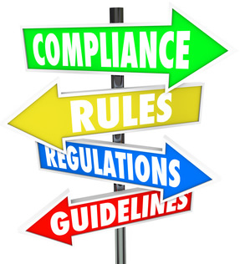
Flavours of Self-regulation
Role of government?
  Statutory rules, degree of oversight, procedures
Role of self-regulators?
  Promulgation, enforcement & monitoring
Legal status
  Non-binding ⬅ ➔ full legal force
Regulatory semantics?
  Self-regulation vs Co-regulation vs Enforced self-regulation vs Meta-regulation
Source: Baldwin & Cave, 2012
Notes:
Self-regulation - ‘a collective group imposes regulation on its components
Co-regulation they take to refer to industry-association self-regulation with some oversight or ratification by government.
Enforced self-regulation, in contrast, involves a subcontracting of regulatory functions
to regulated firms.‘
Meta-regulation’ similarly refers to processes in which the regulatory authority oversees a control or risk management system, rather than carries out regulation directly—it ‘steers rather than rows’. the regulator’s role becomes the auditing, monitoring, and incentivizing of these systems.

Slide 35
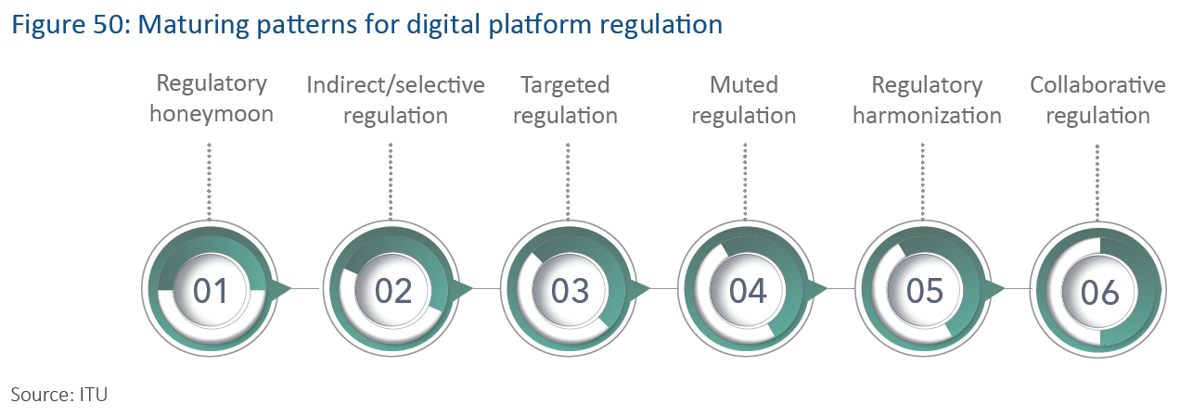
Regulating the Digital Platform Economy
Source: ITU, 2018

Slide 36
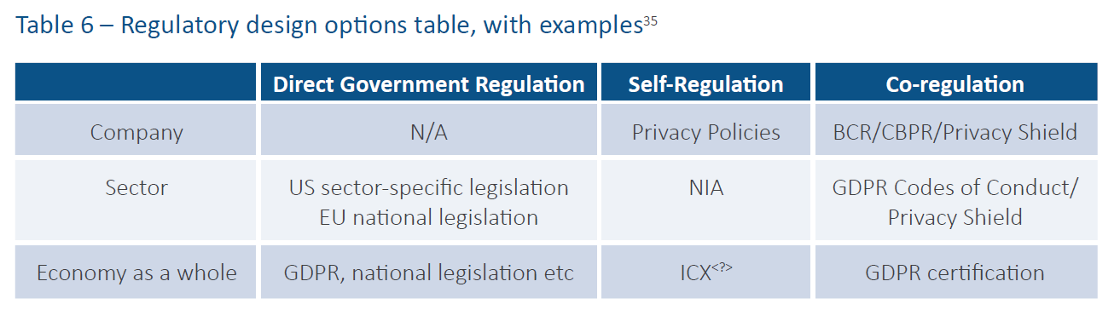
Scope of Self-regulation
ACCC Report
Trans-national examples or initiatives?
  CoE Convention 108 (EU + 4 + 2 African countries)
  AU Cybersecurity Convention (14 signatories, 5 ratifications)
  APEC Cross Border Privacy Rules System
  SADC ICT Consumer Rights and Protection Regulatory Guidelines
  Christchurch Call
  Cross-border problems require cross-border solutions (eg interoperability)
Source: ITU, 2018
Notes:
Self-regulation - ‘a collective group imposes regulation on its components
Co-regulation they take to refer to industry-association self-regulation with some oversight or ratification by government.
Enforced self-regulation, in contrast, involves a subcontracting of regulatory functions
to regulated firms.‘
Meta-regulation’ similarly refers to processes in which the regulatory authority oversees a control or risk management system, rather than carries out regulation directly—it ‘steers rather than rows’. the regulator’s role becomes the auditing, monitoring, and incentivizing of these systems.

Slide 37

Models of
Regulation

Slide 38
The regulatory arena: roles and institutions
Who are the stakeholders and what are their roles?
Government - overall policy process
Legislature - laws / statutes
Regulator - regulations, licences, anti-competitive behaviour
Regulated industry (operators) - lobbying
Public / consumers - consumer protection, QoS, affordability, universal access & service
Labour unions - jobs, more?
Media - public awareness, shape the terms of the debate

Slide 39

Models of Regulation
Differentiated by Scope:
  Competition regulator
  Sector-specific regulator
  Converged regulator
  Multi-sector (utilities) regulator
Differentiated by Composition:
  State regulator
  Single regulator
  Collegial regulatory commission
Advantages? Disadvantages?

Slide 40
Composition of Regulator (1)
Autonomous
  Independent regulator, established under its own statute, executive structures with decision-making power and autonomy (eg OfCom)
Administrative
  eg FCC (US) , head reports to congress, federal jurisdiction only - not at the local carrier level
Government Regulator
  Authority for regulation rests with the minister , usually broad discretion, politically sensitive (eg Antigua, Japan, Korea)
  Does this violate WTO: “The regulatory body is separate from, and not accountable to, any supplier of basic telecommunications services”?

Slide 41

Composition of Regulator (2)
Single-headed Regulators
  Features? Strengths & weaknesses?
  Regulatory oversight by a single individual supported by regulatory staff / consultants
  Able to act more decisively
  But can be arbitrary
  Reduces cost of regulation
  Problems of continuity
  Vulnerable to regulatory capture & political interference (eg Tanzania)

Slide 42

Composition of Regulator (3)
Collegial Regulatory Commission
  Features? Strengths & weaknesses?
  Regulatory oversight by council of commissioners (eg Egypt, South Africa)
  Provides checks and balances, benefit of collective wisdom
  But internal differences can also limit cohesion & consistency
  Part-time vs full-time commissioners?
  Increases cost of regulation
  Continuity through staggered fixed terms
  Less vulnerable to regulatory capture / political interference (but cf Kenya?)

Slide 43
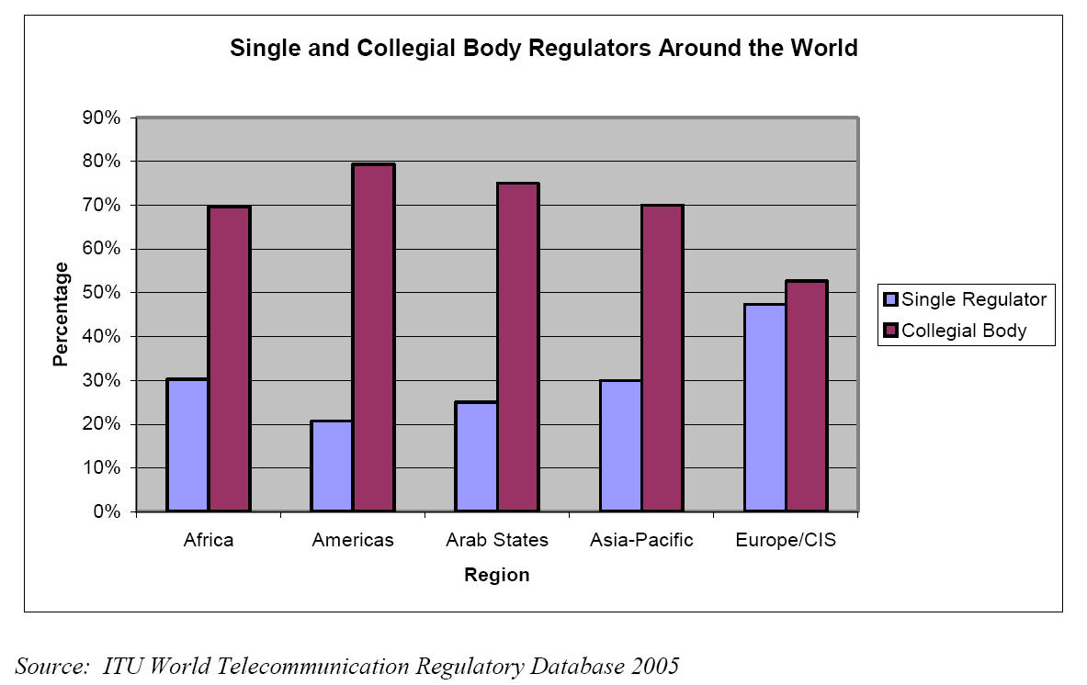
Regulatory Structures Worldwide
Collegial regulators predominate

Slide 44
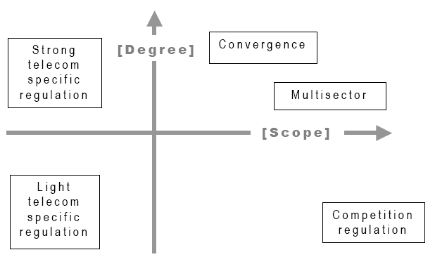
Regulatory Settings: differing degree & scope of regulation
Source: Henten, Samarajiva, & Melody (2002)

Slide 45
Scope of Regulation:
Competition Regulator
Tends to ex post (after the fact) action to rectify problems
Works better in more competitive markets (not monopoly / duopoly / oligopoly)
Applies general competition rules across all sectors
Economies of scale and scope
Able to react to anti-competitive behaviour (eg predatory pricing, cartels, price / margin squeeze)
Lacks sector-specific technical expertise
Less flexible to specific dynamics of the ICT industry
Less vulnerable to regulatory capture
Sometimes able to impose harsher penalties than sector regulation
In SA – co-jurisdictional issues (tensions, “forum-shopping”)
Examples: New Zealand, Jamaica

Slide 46
Scope of Regulation:
Sector-specific Regulator
More proactive – mainly ex ante (before the fact)
Focus on specific industry / sector (eg broadcasting or telecomms)
Can use intensive regulation or light-touch regulation
Requires more sector-specific expertise
Ability to deal with complex industry undergoing rapid technological development
Potentially vulnerable to industry capture
Better able to address social objectives of regulation
May not have adequate enforcement powers under law
May be unwilling to use powers

Slide 47
Sector-specific vs competition regulation
“It is not inconceivable that telecommunications regulatory agencies will eventually disappear, absorbed into multisector antitrust agencies”
  Peter Smith, 1997
“There is ever wider acceptance that industry specific regulation must be a permanent part of the new arrangements at least for as far into the future as can be seen at the moment”
  Bill Melody 1999
What do you think?

Slide 48
Sector-specific vs Convergence Regulation
CONTENT: Information, Entertainment
Access to
Content
Enhancing
Content
APPLICATIONS: Value-adding
Fixed Telecomms
Radio Broadcasting
Transfer of
Content
Enhanced
Communications
Mobile Telecomms
NETWORK SERVICES: Connection and Related
Transfer of
Content
INFRASTRUCTURE:
Transport and Access
etc etc etc…
Source: Hu Hanrahan

Slide 49
Scope of Regulation: Convergence Regulator
Facilitates regulation of converging services & networks & devices (enabled by digitisation)
Based on horizontal model of ICT infrastructure, services, content
Brings together two industries with different regulatory rationales
Difficulties of reconciling issues of infrastructure (telecomms) with those of content (broadcasting)
  eg public service obligations, media concentration rules, publication responsibility, QoS
Difficulties of reconciling divergent legislation (telecomms vs broadcasting)
Promotes economies of scope (for issues common across ICT sector)
Promotes greater regulatory independence
Simplifies regulatory processes for users (one-stop shop)
Risk of political considerations impacting on telecomms
May require specific convergence policies and legislation
Is ICASA a convergence regulator?

Slide 50
Scope of Regulation:
Multi-sector Regulator
Responsibility for several sectors with similar legal & economic characteristics (eg electricity, water, gas) - eg RURA
Able to exploit economies of scale & scope
Reduces cost of regulation
Less vulnerable to regulatory capture
Dilutes sector-specific technical expertise
Increases regulatory certainty (cross-sector application of precedents)
Appropriate for developing countries
Is ICASA a multi-sector regulator?

Slide 51

Regulatory
Practice

Slide 52

Functions of a Regulator
Control market behaviour of (former state-owned) monopoly & ensure fair competition
Promulgate regulations (eg interconnection guidelines) ex ante & ex post
Issue licences (individual, class, type approvals)
Allocation & control of scarce resources (eg spectrum, rights of way, numbering, local loop access)
Monitoring & enforcement (eg regulations, licence conditions, UAS targets, technical standards, QoS)
Dispute resolution (incl interconnection, consumer protection)

Slide 53
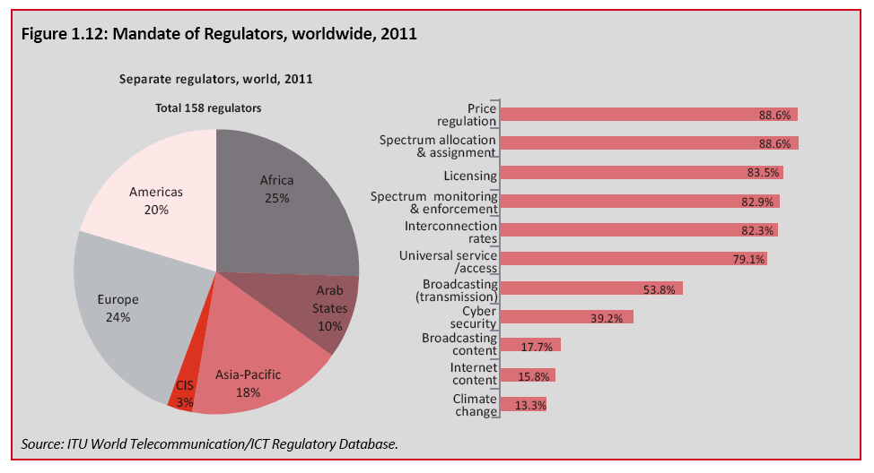
What does the regulator do?
Mandate of the Regulator
Source: ITU Trends in Telecomm Reform, 2012
Notes:
53

Slide 54
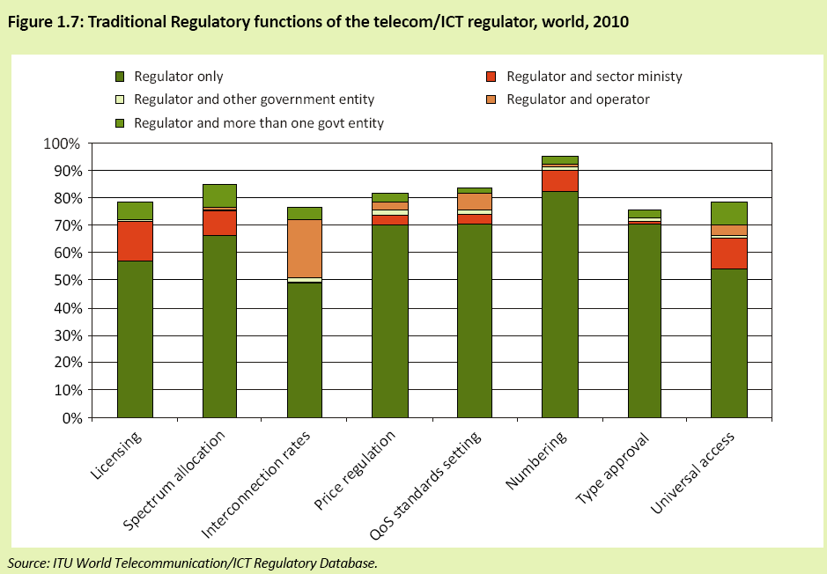
What does the regulator do?
Mandate of the Regulator
Source: ITU, 2011
Licensed under a Creative Commons Attribution NonCommercial NoDerivs 2.0 SA Licence
Notes:
54

Slide 55
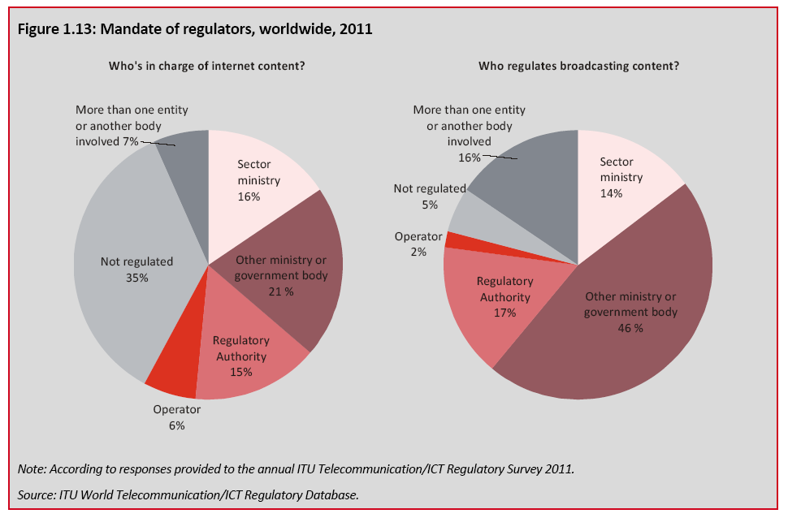
What does the regulator do?
Source: ITU Trends in Telecomm Reform, 2012
Notes:
55

Slide 56
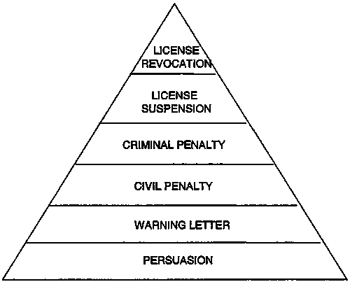
Styles of enforcement
Sanctions
Pyramid
(Hutter)
Criminal
Prosecution
Notices:
Improvement & prohibition
Intrusiveness
Warnings: infractions,
Written & verbal warnings
Persuasion: shaming, deadlines, photographic
evidence, dramatic techniques, education & advice
Notes:
Discuss the importance of these principles in creating a stable sector, conducive to investment, based on credibility of the regulator.
See Baldwin - Chapter 6
Values of Effective Regulation
Accountability: To government; courts; industry and consumers. Accountability embraces independence. Subject to review or appeal procedures, regulators decisions should have a quality of finality and be accorded full recognition.
Openness and transparency: Policies and procedures accessible to all and simple to use. Public hearings and the provision of reasons for decisions.
Objectivity and informed decision-making: Decisions and rules must be based on identified principles and policy. Proper consideration of facts and information will facilitate sound decision-making.
Fairness: Performance of statutory functions in an impartial, equitable, lawful, unbiased and just manner. Fairness produces trust, credibility and legitimacy.
Effectiveness and efficiency: Streamlined and timely procedures, managed resources; co-ordinated services and avoidance of duplication. Efficiency need not conflict with transparency.
Integrity and independence: Exercise of statutory powers without interference or external pressure. All stakeholders treated equally and with respect.
Professional/consistent: Production of accurate, relevant, dependable, understandable information and results.

Slide 57
Rules & enforcement
Rules appropriate to regulatory strategy and degree of enforcement needed (eg prosecution vs guidelines)
Analyse:
  Subject of regulation (well-intentioned, well-informed vs ill-intentioned, ill-informed etc)
  What behaviour is the subject of regulation?
  Who is the responsible party?
  What is the appropriate enforcement strategy?
  What rules are complementary?
Problem of ‘creative compliance’ - adhere to rules by circumventing their scope to breach their spirit
Problem of over-inclusiveness (and under-inclusiveness)
  Regulators tend to over-regulate
  Compare these formulations:
  No person over 60 may pilot a commercial aircraft
  No person posing an unreasonable risk of an accident may pilot a commercial aircraft
  No person falling within the following categories may pilot a commercial aircraft (tables of age, blood-pressure, flying experience etc)
Source: Baldwin & Cave, 2012

Slide 58
Enforcement: when to intervene
Preventive Intervention (ex ante)
  Where impact of transgression is significant
  Where ex post intervention is costly
  Can be restricted by informational difficulties
Act-based Intervention (ex post)
  Where enforcement costs or informational difficulties prevent earlier intervention
Harm-based Intervention (ex post)
  Where enforcement costs or informational difficulties prevent earlier intervention
Degree & severity of sanction in each case?
Examples from ICT sector?
Source: Baldwin & Cave, 1999

Slide 59

How much to enforce
Perfect compliance is not possible
Enforcement costs proportional to level of compliance
Ensure costs of enforcement don’t exceed benefit to society
Costs include:
  Cost of agency monitoring
  Costs of litigation
    (prosecution & defence)
  Costs of errors and misapplications
What is the deterrence effect of enforcement? (probability of sanction x quantum of sanction)
Avoid over-sanction or under-sanction
Sanctions include: fines, equity fines, punitive injunctions, corporate probation, compensation orders, adverse publicity
  Strengths & weaknesses?
  Other sanctions used in ICT sector in your country?
Source: Baldwin & Cave, 2012

Slide 60

Codes of Conduct to
Protect Consumers

Slide 61

Consumer Protection Landscape in your Country?
Legal Framework
  International guidelines
  Constitution
  Administrative law
  Competition law
  Consumer protection law
  Sector-specific legislation (eg telecomms law)
Institutional Arrangements
  Consumer protection regulator
  Competition regulator
  ICT sector regulator
  Consumer bodies
Co-jurisdiction?

Slide 62


Codes of Conduct
WASPA (Wireless Application Service Providers’ Association) (100+ members)
  Self-regulatory Code of Conduct (2005 – 2016 v 14.5)
  mandatory for all members
  on WASPA and member web sites
  both a detailed code of conduct (eg competitions, adult content) and complaint structure & procedures
  Major mobile operators require WASPA membership via IRB Code of Conduct (signed Nov 2005)
ISPA (177 member ISPs)
  12 section self-regulatory code of conduct (2002 - 2016)
  mandatory for all members
  in line with ECT Act requirements
  IRB since 2009

Slide 63

Regulatory
Governance

Slide 64
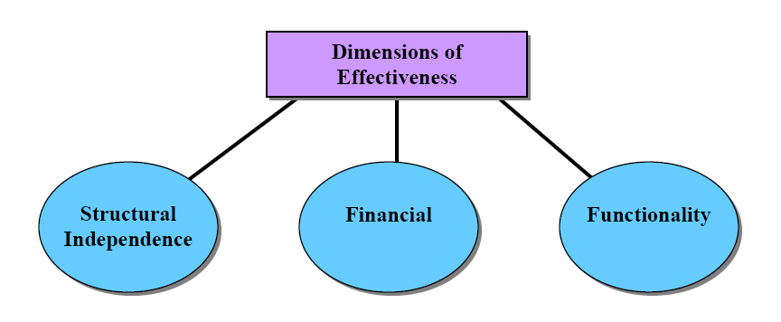
Requirements for Regulatory Effectiveness
Regulatory effectiveness depends on
Structural independence
Financial independence & resources
Functional competence & autonomy
Source: Telecommunications
Management Group, Inc

Slide 65
Principles of Good Regulatory Governance
“The decisions of and the procedures used by regulators shall be impartial with respect to all market participants” - WTO
Principles of good regulatory decision-making:
  Accountability (to govt, courts, industry, consumers)
  Transparency (publication, process, participation - open & simple)
  Objectivity (criteria, procedures, no conflicts of interest)
  Fairness (incl appeal procedures)
  Efficiency (streamlined, simple procedures - balance with transparency)
  Independence (checks & balances)
  Professionalism
Notes:
Discuss the importance of these principles in creating a stable sector, conducive to investment, based on credibility of the regulator.
See Baldwin - Chapter 6
Values of Effective Regulation
Accountability: To government; courts; industry and consumers. Accountability embraces independence. Subject to review or appeal procedures, regulators decisions should have a quality of finality and be accorded full recognition.
Openness and transparency: Policies and procedures accessible to all and simple to use. Public hearings and the provision of reasons for decisions.
Objectivity and informed decision-making: Decisions and rules must be based on identified principles and policy. Proper consideration of facts and information will facilitate sound decision-making.
Fairness: Performance of statutory functions in an impartial, equitable, lawful, unbiased and just manner. Fairness produces trust, credibility and legitimacy.
Effectiveness and efficiency: Streamlined and timely procedures, managed resources; co-ordinated services and avoidance of duplication. Efficiency need not conflict with transparency.
Integrity and independence: Exercise of statutory powers without interference or external pressure. All stakeholders treated equally and with respect.
Professional/consistent: Production of accurate, relevant, dependable, understandable information and results.

Slide 66
Eight Principles of Regulatory Decision-making
Decisions must be within legal authority of regulator
The regulator must consider all relevant matters and disregard irrelevant ones
Decisions must be made in good faith and for proper purposes
Factual underpinnings of decisions must be based on evidence
Decisions must be reasonable
Those affected by a decision must be accorded procedural fairness (including the right to respond to prejudicial arguments and evidence that may be taken into account)
Government policy must be properly applied
Independent regulators must not act on the direction of other persons
Source: Intven, 2001, Australian Communications Authority

Slide 67
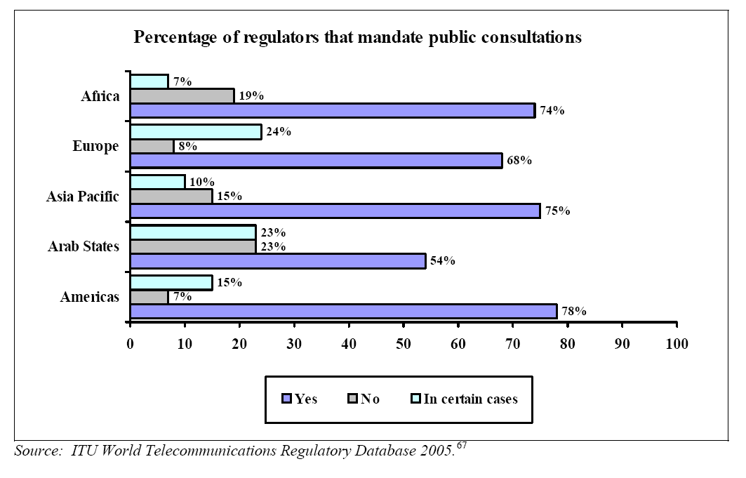
Regulatory Transparency

Slide 68

Regulatory process & effectiveness
Clear & public regulatory procedures (notices, regulations, orders and resolutions)
  In accordance with Constitution & Administrative Justice Act
  Afford all interested parties opportunity to be heard
  Avoid conflict of interest situations
Determinants of regulatory effectiveness (Makhaya):
  Political will
  Independence (legal vs in practice)
  Resources
  Legitimacy & credibility
Notes:
Discuss the importance of these principles in creating a stable sector, conducive to investment, based on credibility of the regulator.
See Baldwin - Chapter 6
Values of Effective Regulation
Accountability: To government; courts; industry and consumers. Accountability embraces independence. Subject to review or appeal procedures, regulators decisions should have a quality of finality and be accorded full recognition.
Openness and transparency: Policies and procedures accessible to all and simple to use. Public hearings and the provision of reasons for decisions.
Objectivity and informed decision-making: Decisions and rules must be based on identified principles and policy. Proper consideration of facts and information will facilitate sound decision-making.
Fairness: Performance of statutory functions in an impartial, equitable, lawful, unbiased and just manner. Fairness produces trust, credibility and legitimacy.
Effectiveness and efficiency: Streamlined and timely procedures, managed resources; co-ordinated services and avoidance of duplication. Efficiency need not conflict with transparency.
Integrity and independence: Exercise of statutory powers without interference or external pressure. All stakeholders treated equally and with respect.
Professional/consistent: Production of accurate, relevant, dependable, understandable information and results.

Slide 69
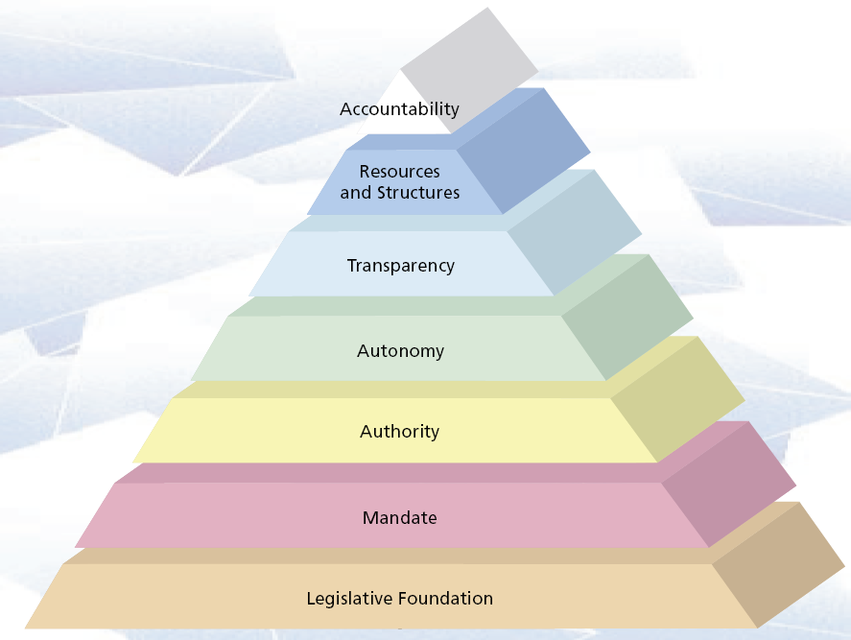
Building blocks of regulatory effectiveness
Source: Leavey, 2004

Slide 70

Assessing Regulatory Effectiveness…
LINK Centre / researchICTafrica survey, 2007
Stakeholder questionnaire, supplemented by interviews
Examined 6 dimensions
  Market Entry & Licensing
  Scarce Resources (spectrum, numbering, rights of way)
  Interconnection and Facilities
  Tariff Regulation
  Regulation of Anti-competitive Practices
  Universal Service Obligation
Index of Telecomms Regulatory Effectiveness (TRE)
Other assessment tools include
  Regulatory Scorecard (ECTA)
  Telecoms Regulatory Governance Index (TRGI)

Slide 71
Index of Regulatory Effectiveness
Source: researchICTafrica

Slide 72
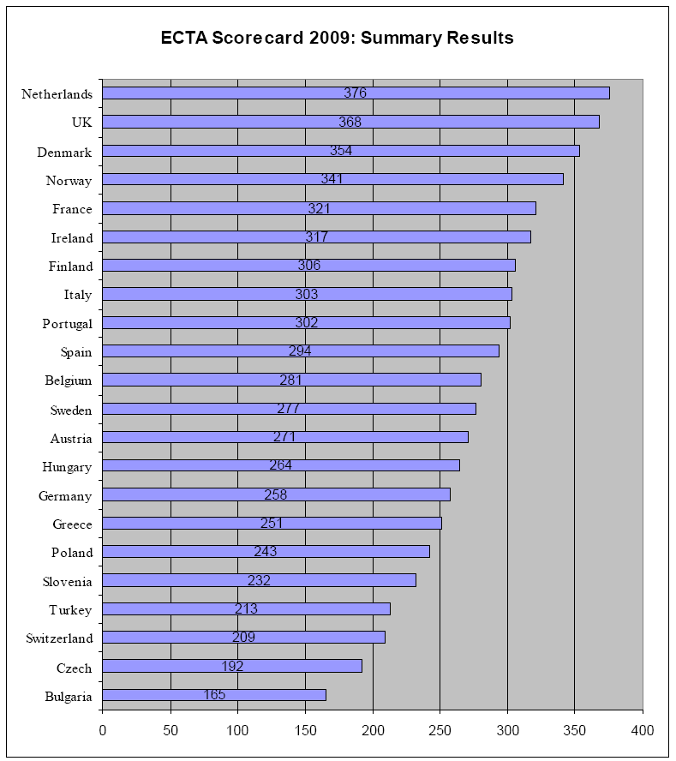

ECTA’s Regulatory Scorecard
ECTA, 2009
European Competitive Telecomms Association
Licensed under a Creative Commons Attribution NonCommercial NoDerivs 2.0 SA Licence
Notes:
72

Slide 73
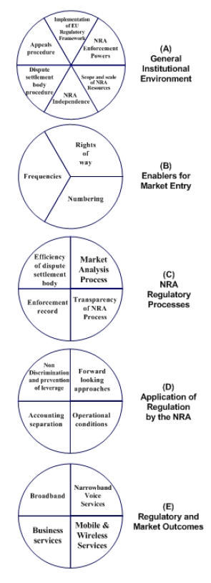
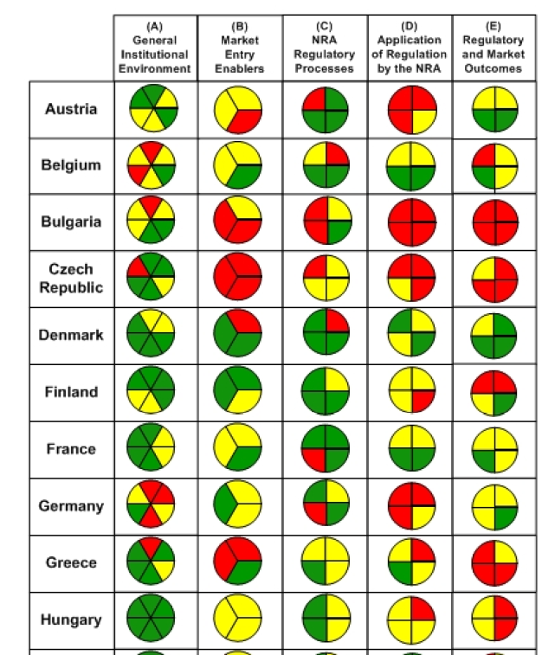
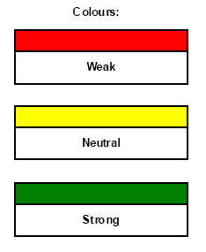
ECTA’s Regulatory Scorecard
Licensed under a Creative Commons Attribution NonCommercial NoDerivs 2.0 SA Licence
Notes:
73

Slide 74
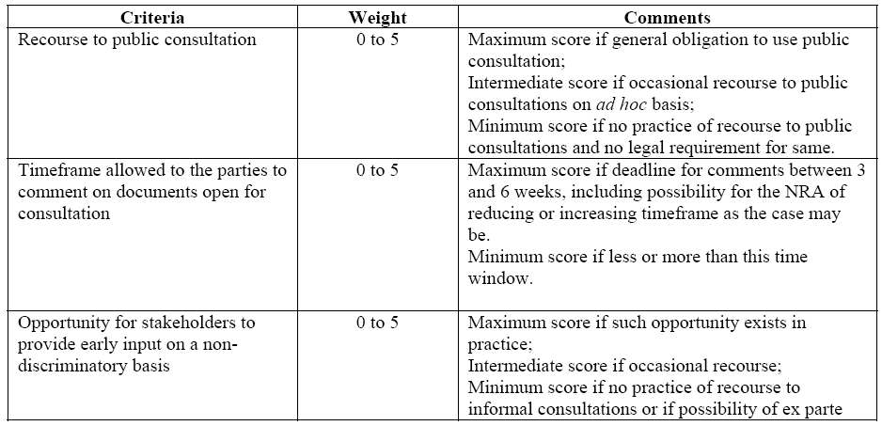
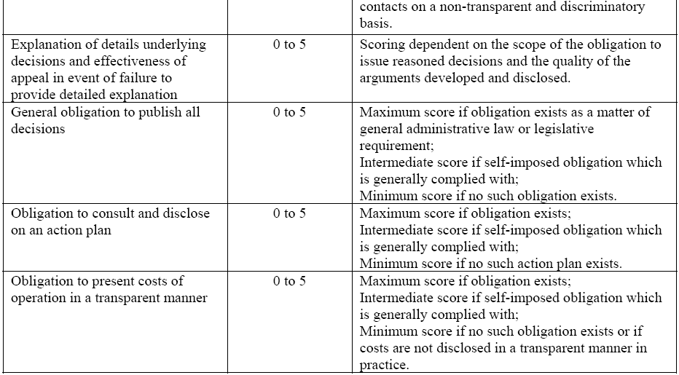
ECTA’s
Regulatory
Scorecard
Licensed under a Creative Commons Attribution NonCommercial NoDerivs 2.0 SA Licence
Notes:
74

Slide 75
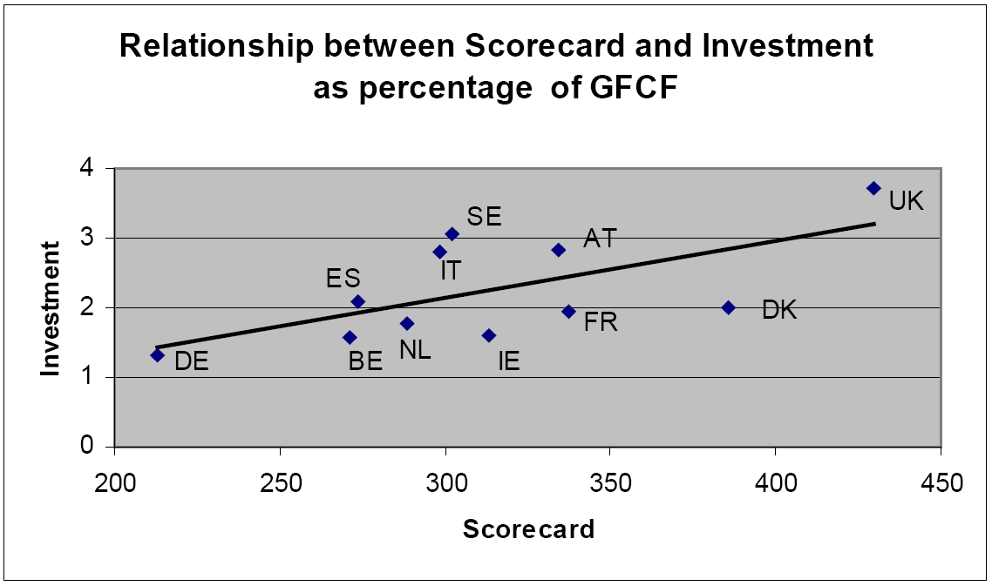
Regulatory Effectiveness
Correlates with Investment
Source: ECTA, 2005
Licensed under a Creative Commons Attribution NonCommercial NoDerivs 2.0 SA Licence
Notes:
75

Slide 76
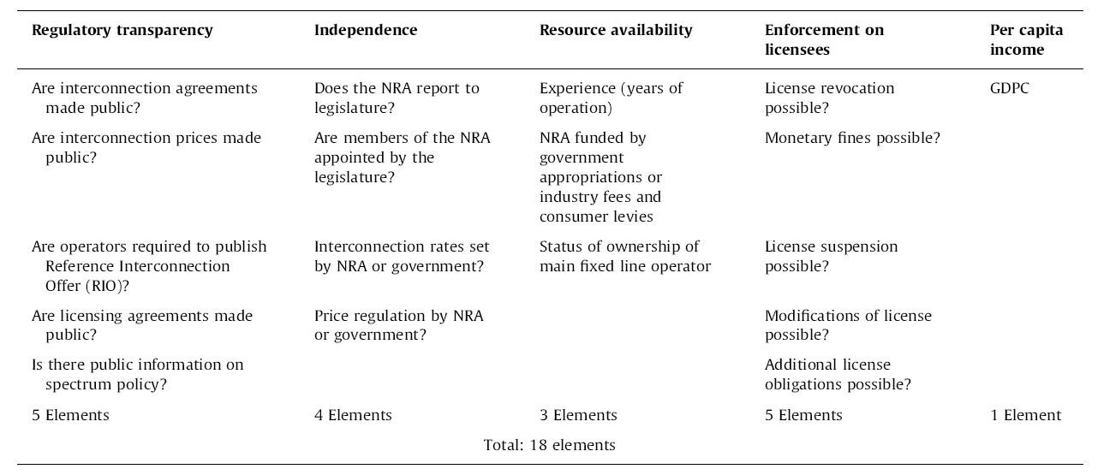
TRGI:
Telecoms Regulatory Governance Index
Source: Waverman & Koutroumpis, 2011

Slide 77

ITU:
Generations of Regulation
G1: Regulated public monopolies – command & control approach
G2: Basic reform – partial liberalisation & privatisation across the layers
G3: Enabling investment, innovation & access – dual focus on stimulating competition in service & content delivery, & consumer protection
G4: Integrated regulation – led by economic & social policy goals
Source: ITU

Slide 78
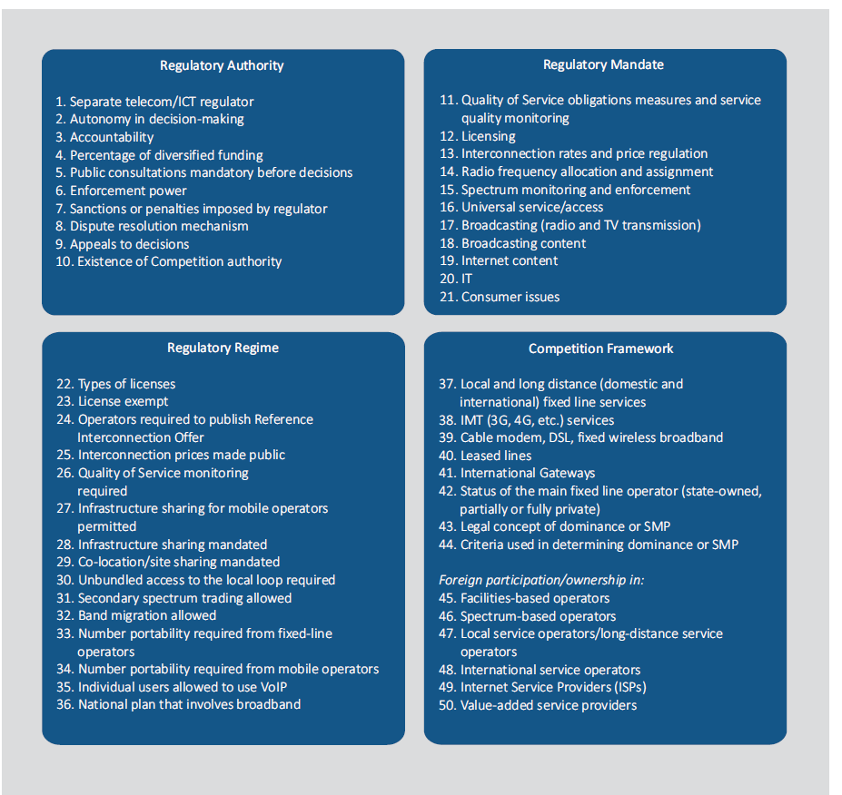
ITU Regulatory Tracker
Source: ITU, 2015

Slide 79

Concluding thoughts…

Slide 80
Summary
Collaborative self-regulation has a key role in the evolving digital platform economy
But operators will protect market share & financial bottom lines
Public interest & consumer protection remain primary regulatory objectives
Self-regulatory / co-regulatory models need to accommodate multiple objectives
Digital platforms require national / regional / supra-national models & interventions
Notes:
As more countries increasingly liberalise their telecomms sectors, the rationale for regulation remains important to facilitate a smooth transition to competition, ensure equitable access to market and assist in reaching universal access/service.
Even once competition is achieved, regulatory authorities continue to play an important role.
However, there are many lessons already at hand for regulators to draw on, and developing countries are well placed to ensure that the tried and tested methods are used, and those that are less efficient are discarded.
In addition, countries may tailor different aspects of regulation to suit their specific local contexts. The wholesale adoption of one single regulatory model from another jurisdiction is rarely sufficient on its own, and requires adaptation to different legal systems and markets.
Good regulatory governance not only ensures transparency and fairness, but will facilitate clear roles and relationships between the various stakeholders and policy players concerned.
Independence in the implementation of government policy is crucial to ensuring that the above goals are met.

Slide 81

Thank you - questions?
http://www.ICT-Policy.Africa
Charley@ICT-Policy.Africa

