Slide 2



ITU Digital Consumer Forum 2019
Regulatory Mandates for
Digital Financial Services
Dr Charley Lewis
Notes:
2

Slide 3
What is Money?
Source: World Bank, 2017
Source: IMF, 2019

Slide 4

Digital Financial Services
“broad range of financial services accessed and delivered through digital channels, incl payments, credit, savings, remittances & insurance”
  Mobile money (M-Pesa)
  Cryptocurrencies (BitCoin, Libra (?))
Promotes financial inclusion (banking the unbanked)
Mobile money
  Two-sided platform market (users & agents)
  Globally: 272 services in 93 countries with 866 million customers (35% active)
  Africa: 132 services with 396 million accounts (37%)
  But still largely basic transfers & payments
Considerable attention from: GSMA, UN, IMF, ITU

Slide 5
Financial Inclusion
Source: World Bank, 2017
But 2/3 of unbanked adults have a mobile phone…

Slide 6
Mobile Money in Africa
Source: GSMA, 2017

Slide 7
Mobile Money Trends
Source: GSMA, 2019
Source: GSMA, 2019

Slide 8
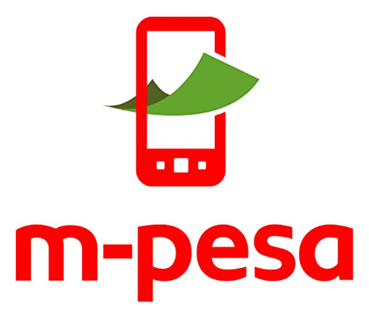
Mobile Money in Africa
Source: GSMA, 2019
Source: GSMA, 2017

Slide 9
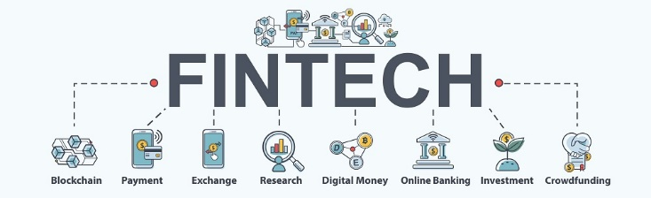
Challenges of DFS regulation
Regulating market entry (licensing)
Regulatory co-jurisdiction & co-ordination
  ICT sector, financial sector, competition, consumer protection
  Also DPAs, financial intelligence
  Need for clear, functional MoUs
Data protection & privacy
Service-based vs institution-based regulation
Dealing with network effects - DFS as a platform service
  Imposing interoperability (Kenya)
Dealing with cross-border DFS
Regulatory sandboxes (consumer downside)
Dealing with Unlicensed Digital Investment (ponzi) Schemes (UDIS)
Implications of cryptocurrencies & blockchain (IMF, EU, Swiss, SARB)

Slide 10
Regulatory Responses
Widening the regulatory net - to include?
Imposing consumer protection codes of conduct
Governance requirements for DFS firms
Regulating data management & AI - data protection
Specifying risk management requirements
Requiring cybersecurity measures
Endorsing industry codes
Conducting research & producing issue reports & position papers
Source: KPMG, 2019

Slide 11

DFS User Agreements: Consumer Protection Issues
Language & transparency in communications / contracts
Fees and charges
Data protection vs 3rd party sharing (only 20%)
Unilateral changes to terms and conditions
Complaints handling
Dispute resolution procedures incl mandatory arbitration (50% legal fees indemnity)
Fraud & funds protection (only 50%)
Reversal of erroneous transactions (only 6%)
PIN safety warnings
Dormancy period
Customer funds at death

Slide 12

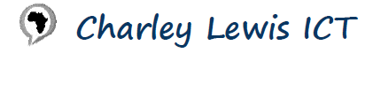
Thank you - questions?
Charley@ICT-Policy.Africa

